Slide 1


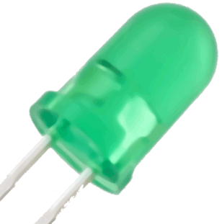
Functional Slot Card 1 (+)
Functional Slot Card 2 (+)
Functional Slot Card 3 (+)
Functional Slot Card 4 (+)
Functional Slot Card 5 (+)
Rectification Slot Card 2
Controller Slot Card
Functional Slot Card 6 (-)
Rectification Slot Card 1
Rectification Slot Card 3

Slide 2
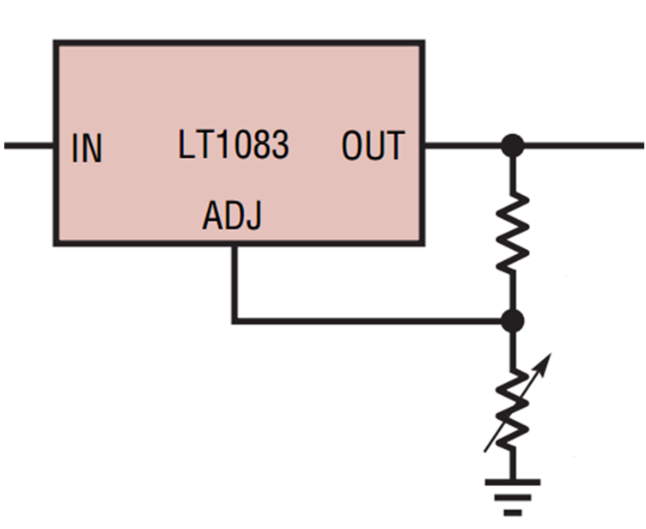
Vout
Rshunt
RDAC

Slide 3
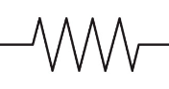
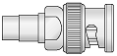

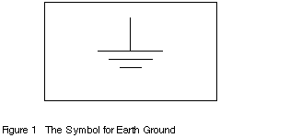
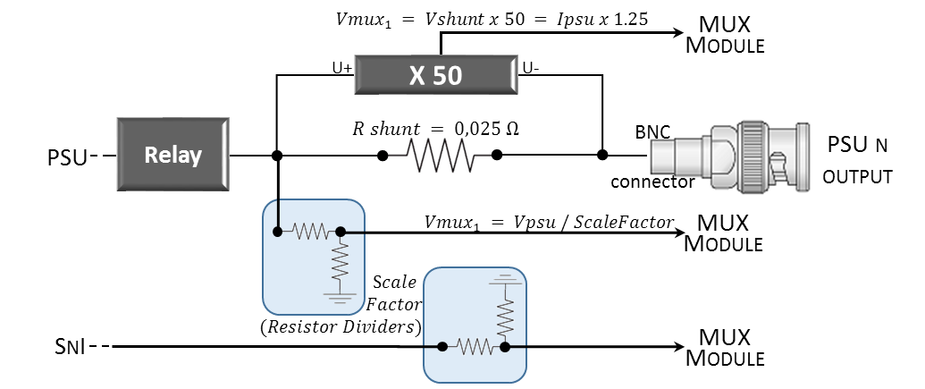




$$Vmux_{1} = Vshunt x 50 = Ipsu x 1.25$$
MUX Module
U+
X 50
U-
PSU
Relay
$$R shunt = 0,025 Ω$$
BNC
connector
PSU n output
$$Vmux_{1} = Vpsu / ScaleFactor$$
MUX Module
$$Scale$$
$$Factor$$
$$(Resistor Dividers)$$
SnI
MUX Module

Slide 4
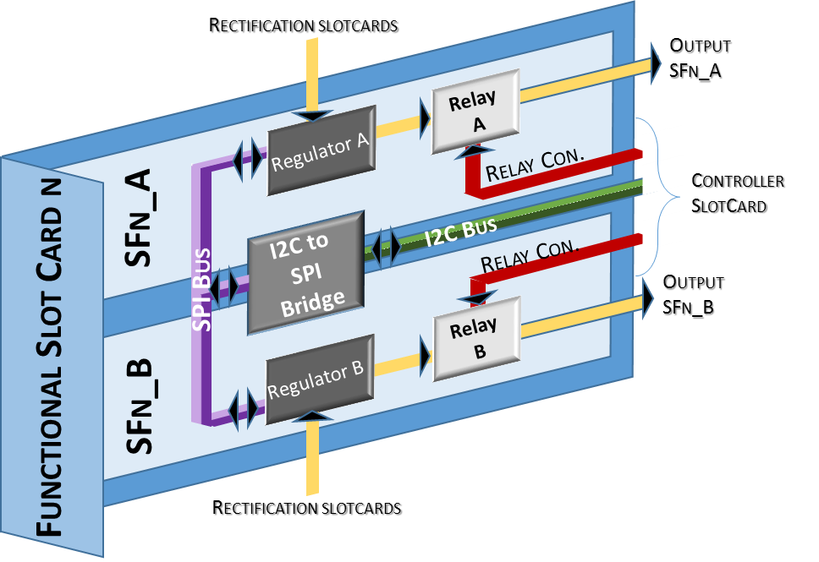
Rectification slotcards
Output SFn_A
Relay A
Regulator A
Relay Con.
Controller
SlotCard
SFn_A
I2C Bus
SPI Bus
I2C to SPI Bridge
Relay Con.
Output SFn_B
Functional Slot Card n
Relay B
SFn_B
Regulator B
Rectification slotcards

Slide 5
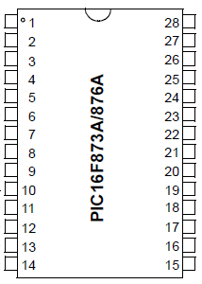
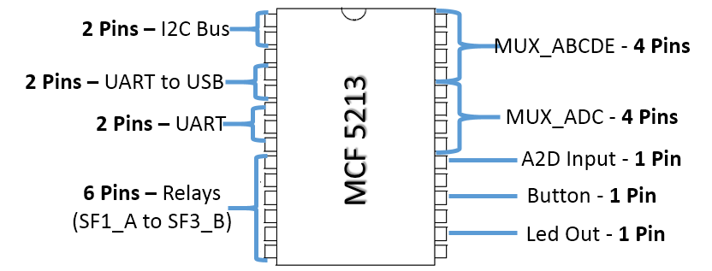
2 Pins – I2C Bus
MUX_ABCDE - 4 Pins
2 Pins – UART to USB
2 Pins – UART
MCF 5213
MUX_ADC - 4 Pins
6 Pins – Relays
(SF1_A to SF3_B)
A2D Input - 1 Pin
Button - 1 Pin
Led Out - 1 Pin

Slide 6
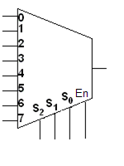
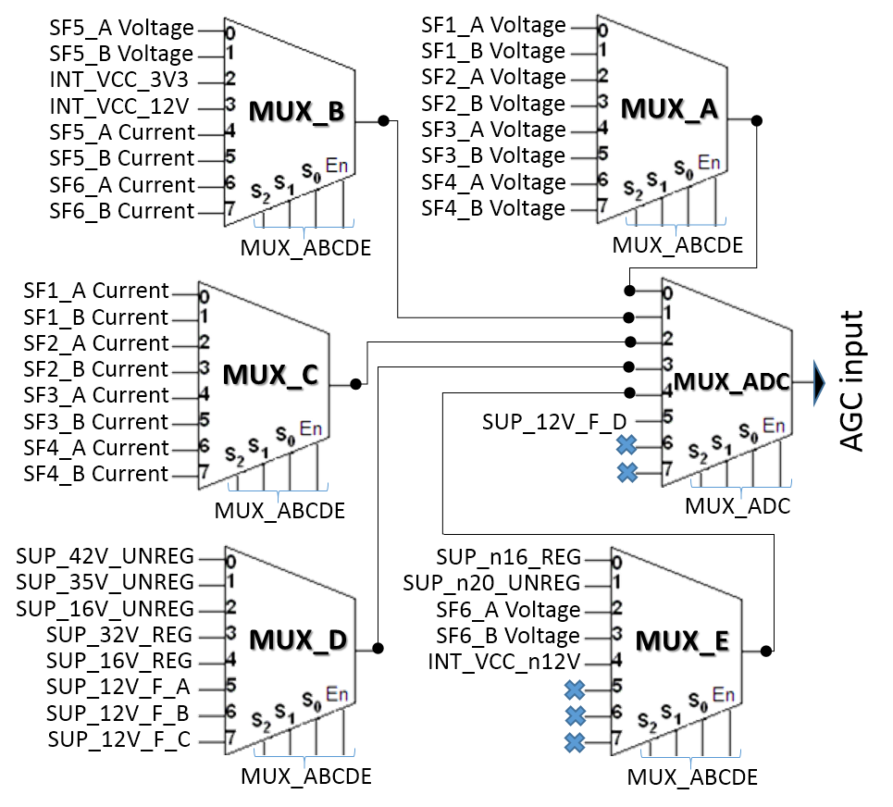
SF5_A Voltage
SF1_A Voltage
SF5_B Voltage
SF1_B Voltage
INT_VCC_3V3
SF2_A Voltage
INT_VCC_12V
MUX_B
SF2_B Voltage
MUX_A
SF5_A Current
SF3_A Voltage
SF5_B Current
SF3_B Voltage
SF6_A Current
SF4_A Voltage
SF6_B Current
SF4_B Voltage
MUX_ABCDE
MUX_ABCDE
SF1_A Current
SF1_B Current
SF2_A Current
SF2_B Current
MUX_C
MUX_ADC
AGC input
SF3_A Current
SUP_12V_F_D
SF3_B Current
SF4_A Current
SF4_B Current
MUX_ABCDE
MUX_ADC
SUP_42V_UNREG
SUP_n16_REG
SUP_35V_UNREG
SUP_n20_UNREG
SUP_16V_UNREG
SF6_A Voltage
SUP_32V_REG
MUX_D
SF6_B Voltage
MUX_E
SUP_16V_REG
INT_VCC_n12V
SUP_12V_F_A
SUP_12V_F_B
SUP_12V_F_C
MUX_ABCDE
MUX_ABCDE

Slide 7
MAGNITUDE |  | MUX_ABCDE | MUX_ADC | SCALE FACTOR
PSU Voltages | SF1_A Voltage | 0 | 0 | 3
 | SF1_B Voltage | 1 | 0 | 3
 | SF2_A Voltage | 2 | 0 | 3
 | SF2_B Voltage | 3 | 0 | 3
 | SF3_A Voltage | 4 | 0 | 3
 | SF3_B Voltage | 5 | 0 | 3
 | SF4_A Voltage | 6 | 0 | 3
 | SF4_B Voltage | 7 | 0 | 3
 | SF5_A Voltage | 0 | 1 | 3
 | SF5_B Voltage | 1 | 1 | 3
 | SF6_A Voltage | 2 | 4 | -1.68
 | SF6_B Voltage | 3 | 4 | -1.68
PSU Currents | SF1_A Current | 0 | 2 | 1.25
 | SF1_B Current | 1 | 2 | 1.25
 | SF2_A Current | 2 | 2 | 1.25
 | SF2_B Current | 3 | 2 | 1.25
 | SF3_A Current | 4 | 2 | 1.25
 | SF3_B Current | 5 | 2 | 1.25
 | SF4_A Current | 6 | 2 | 1.25
 | SF4_B Current | 7 | 2 | 1.25
 | SF5_A Current | 4 | 1 | 1.25
 | SF5_B Current | 5 | 1 | 1.25
 | SF6_A Current | 6 | 1 | -1.25
 | SF6_B Current | 7 | 1 | -1.25
SnI Voltages | SUP_42V_UNREG | 0 | 3 | 5
 | SUP_35V_UNREG | 1 | 3 | 3
 | SUP_16V_UNREG | 2 | 3 | 1.68
 | SUP_32V_REG | 3 | 3 | 3
 | SUP_16V_REG | 4 | 3 | 3
 | SUP_12V_F_A | 5 | 3 | 3.68/3
 | SUP_12V_F_B | 6 | 3 | 3.68/3
 | SUP_12V_F_C | 7 | 3 | 3.68/3
 | SUP_n16_REG | 0 | 4 | -1.68
 | SUP_n20_UNREG | 1 | 4 | -2
 | SUP_12V_F_D | - | 5 | 3.68/3
 | INT_VCC_3V3 | 2 | 1 | 1
 | INT_VCC_12V | 3 | 1 | 1
 | INT_VCC_n12V | 4 | 4 | -1

Slide 8

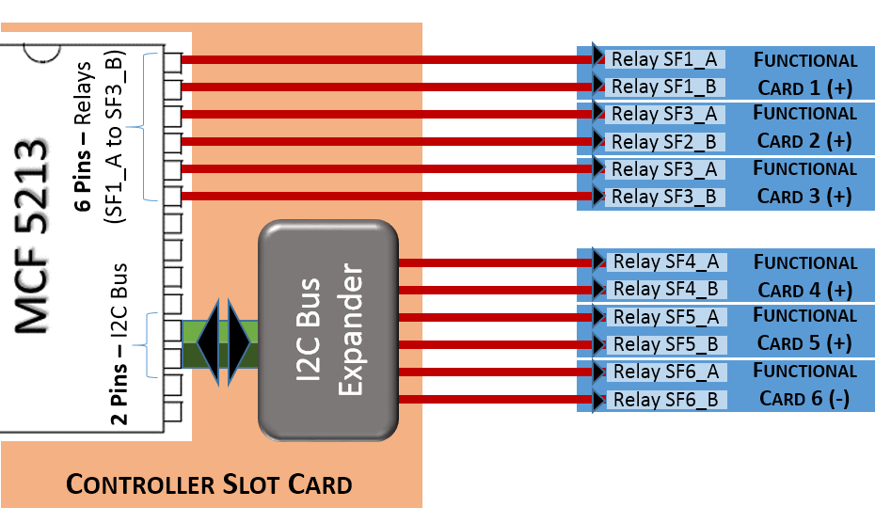
Relay SF1_A
Functional Slot Card 1 (+)
Relay SF1_B
Functional Slot Card 2 (+)
6 Pins – Relays
(SF1_A to SF3_B)
Relay SF3_A
Relay SF2_B
Functional Slot Card 3 (+)
Relay SF3_A
Relay SF3_B
I2C Bus Expander
Relay SF4_A
Functional Slot Card 4 (+)
Relay SF4_B
Functional Slot Card 5 (+)
2 Pins – I2C Bus
Relay SF5_A
Relay SF5_B
Functional Slot Card 6 (-)
Relay SF6_A
Relay SF6_B
Controller Slot Card

Slide 9

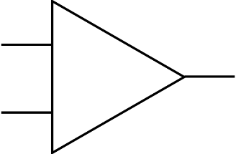
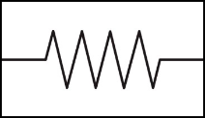
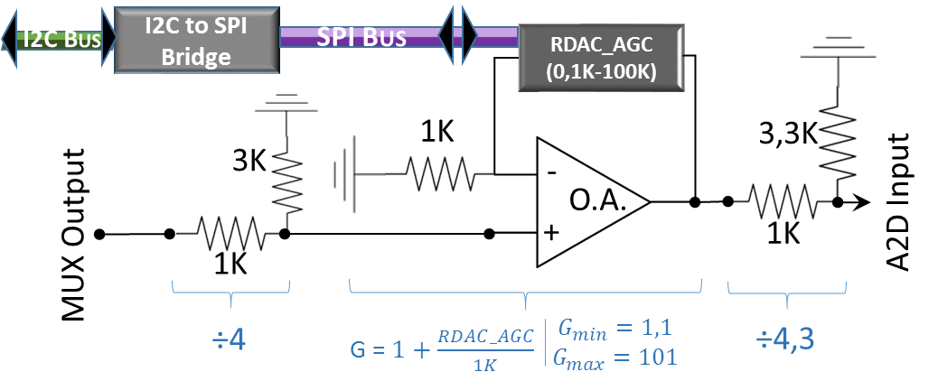


I2C Bus
I2C to SPI Bridge
SPI Bus
RDAC_AGC
(0,1K-100K)
3K
1K
3,3K
-
O.A.
A2D Input
MUX Output
1K
+
1K
÷4
G = $1+\frac{RDAC_AGC}{1K}$
$$G_{min}=1,1$$
$$G_{max}=101$$
÷4,3

Slide 10
I2C Bus
Relays
SFs 1 to 6
SFs 1 to 6
MUX Module
AGC Module
Relay Connections
PSUs Volt/Curr
A2D
SW_BUTTON
Button
MUX_ABCDE + MUX_ADC
LED OUT ON
LED
UART
UART to USB
USB
PC

Slide 11


Functional Slot Card (x6)
Relays
Controller
SFn_A (x2)
x 12
AlarmCTRL
Relay Library
ConfigCTRL
I2C to SPI Bridge
DataListsCTRL
I2C Bus _
I2C&SPI
Library
I2C&SPILibrary
SPI
Bus
AGC Module
A2D
FlashMemCTRL
I2C&SPI
Library
AGCLibrary
MonitorCTRL
RDAC
x 1
SwitchOnCTRL
RDAC
Library
MUX Module
VoltCurrCTRL
MUX
Relay
MUXLibrary
Interface
UART
/
USB
Relay
Library
Tests
x 38
Voltages/Currents

Slide 12
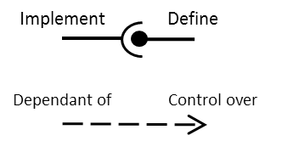
General
Program
Display
Libraries
Config
I2C&SPI
AGC
MUX
RDAC
Relay
Status
Config
Switch On/Off
Change Voltage
Configure Alarms
Toggle Alarms
Alarm Period
SnIs inclusion
I2C/RDAC Console Output
TESTS
Package:
Interface
Test Main
Controller Tests
Libraries’ Tests
TEST Interruption Timers
TEST Alarm
TEST DataLists
TEST FlashMem
TEST Monitor
TEST SwitchOn
TEST VoltCurr
TEST I2C&SPI
TEST RDAC
TEST AGC
TEST Relay
TEST MUX
Package:
Tests
ConfigCTRL
DataListsCTRL
FlashMemCTRL
Package:
Controller
VoltCurrCTRL
AlarmCTRL
MonitorCTRL
SwitchOnCTRL
Package:
Libraries
MUX Library
Relay Library
RDAC Library
AGC Library
I2C&SPI Library
PSU_TYPE.cpp
defineConstants.cpp
Typedefs
Interruption.cpp
headers.h
SnI_TYPE.cpp
main.cpp
Implement
Define
Dependant of
Control over

Slide 13
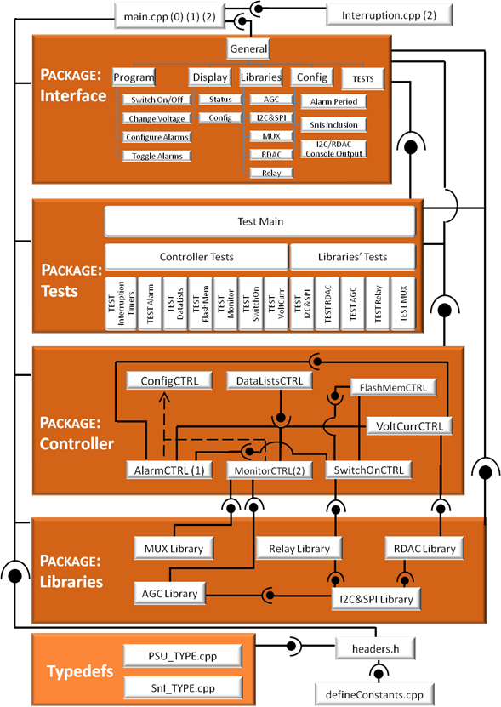
Top
Lvl 1
Lvl 2
IV
III
II
I
Bottom

Slide 14
Interface Menu
(1) Display Menu
(2) Program Menu
(3) Libraries Menu
(4) Test Menu
(5) Configuration Menu
(+) Pause/Resume alarm Task
(-) Pause/Resume monitor Task
Display Menu
Display Status
Display PSU Config
Display SnI Config
(e) Back to Interface Menu
ProgramMenu
Switch ON/OFF PSUs
Change Output Voltage PSUs
Connect/Disconnect Alarms PSUs
(5) Initialization Timer PSUs
(+) Default Values PSUs
(7) Connect/Disconnect Alarms SnIs
(-) Default Values SnIs
(4) Configure Alarms PSUs (6) Configure Alarms SnIs
(e) Back to Interface Menu
Test Menu
Libraries' Tests
Controller Tests
(e) Back to Interface Menu
Libraries
Test
Menu
TEST_I2CSPILibrary
TEST_RDACLibrary
TEST_AGCLibrary
TEST_RelayLibrary
TEST_MUXLibrary
(+) Change I2C Address destination
(-) Toggle SPI Selected slave
(*) Set I2C & SPI addresses for a PSU
(q) Configure both I2C & SPI Channels
(e) Back to Test Menu
I2C&SPI
Library
Menu
Configure both I2C & SPI Channels
Send I2C configurable message
(+) Change I2C Address destination
(-) Toggle SPI Selected slave
(*) Set I2C & SPI addresses for a PSU
(e) Back to Libraries Menu
AGC
Library
Menu
Minimum AGC Gain
Maximum AGC Gain
Scale AGC Gain
Set AGC Gain
Convert Gain to RDAC Counts
Convert RDAC Counts to Gain
Get Current Gain and Counts
(e) Back to Libraries Menu
Controller
Test
Menu
TEST_TIMER_INTERRUPTS
TEST_AlarmCTRL
TEST_DataListsCTRL
TEST_FlashMemCTRL
TEST_MonitorCTRL
TEST_SwitchOnCTRL
TEST_VoltCurrCTRL
(e) Back to Test Menu

Slide 15
Config
Menu
Configure Alarm Update period
Include/Exclude SnIs in tasks
Simulate measures
Toggle RDACLibrary console output
Toggle I2CnSPILibrary console output
(e) Back to Interface Menu
Alarm Configuration
Menu
Alarm Limit Time
Alarm Limit Value
Alarm Protocols to be activated
Protocol Shutdown PSUs
Protocol Modify Voltage
(e) Back to Program Menu
MUX
Library
Menu
Set Muxes for a reading
Read PSU voltage
Read PSU current
Read SnI voltage
Get Muxes' status
(e) Back to Libraries Menu
Relay
Library
Menu
Connect PSU Relay
Disconnect PSU Relay
(3) Relays' Status
(e) Back to Libraries Menu
RDAC
Library
Menu
Change RDAC Value
Read RDAC Value
Change RDAC Control Register
Read RDAC Control Register
Reset RDAC
High Impedance on SDO for RDAC
Scaled (+1,-1) change of RDAC value
Program RDAC Value in 20TP-Mem
Read RDAC 20TP-Mem Value
Convert Volts to RDAC Counts
Convert RDAC Counts to Volts
(+) Change I2C Address destination
(-) Toggle SPI Selected slave
(*) Set I2C & SPI addresses for a PSU
(e) Back to Libraries Menu

Slide 16
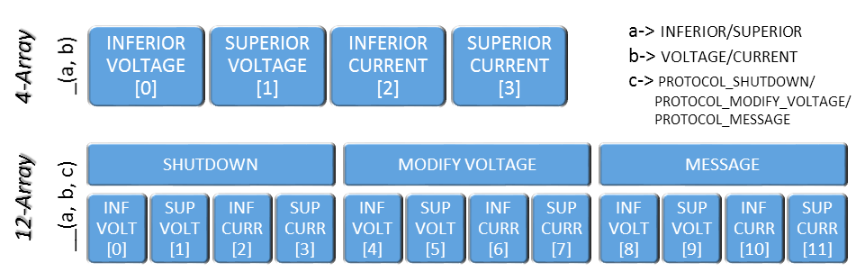
_(a, b)
INFERIOR VOLTAGE [0]
SUPERIOR VOLTAGE [1]
INFERIOR CURRENT [2]
SUPERIOR CURRENT [3]
a-> INFERIOR/SUPERIOR
b-> VOLTAGE/CURRENT
c-> PROTOCOL_SHUTDOWN/
PROTOCOL_MODIFY_VOLTAGE/
PROTOCOL_MESSAGE
4-Array
INF VOLT [0]
SUP VOLT [1]
INF CURR [2]
SUP CURR [3]
SHUTDOWN
MODIFY VOLTAGE
INF VOLT [4]
SUP VOLT [5]
INF CURR [6]
SUP CURR [7]
MESSAGE
INF VOLT [8]
SUP VOLT [9]
INF CURR [10]
SUP CURR [11]
12-Array
__(a, b, c)

Slide 17
[ I2C_ADR | SPI_ADR | B1 | B2 ]
I2C Bus
I2CtoSPI
Bridge
SPI Bus
RDAC
Program RDAC
[ BridgeAddr | RDACAddr| XX | XX ]
[ RDACAddr| XX | XX ]
[ BridgeAddr | RDACAddr| YY | YY ]
[ RDACAddr| YY | YY ]
Read RDAC
[ BridgeAddr | RDACAddr| 00 | 00 ]
[ RDACAddr| 00 | 00 ]
[ BridgeAddr | readBuf ]
[ ZZ | ZZ ]
[ ZZ| ZZ]
I2C Bus
I2C Bus Expander
Relays for PSUs 6 to 11
[ ExpanderAddr |0100 | 11XX ]
Relay PSU 6
Relay PSU 7
Relay PSU 8
Relay PSU 9
Relay PSU 10
Relay PSU 11
1 / 1 / 0 / 0 / 1 / 0

Slide 18
I2C&SPI Library
// I2C communication result
BYTE I2CStat;
// I2C
BYTE sendI2CMessage ( BYTE outputBuffer[],
uint bufSize, BYTE I2CAdress );
// SPI
BYTE configureSPI( BOOL order, BOOL cpol, BOOL cpha,
BYTE clkRate, BYTE I2CtoSPIBridgeAddress );
BYTE sendSPImessage ( BYTE outputBuffer[], uint bufSize,
BYTE slaveSelect, BYTE I2CtoSPIBridgeAddress );
BYTE readI2CBridgeBuffer ( BYTE inputBuffer[],
uint bufSize, BYTE I2CtoSPIBridgeAddress);
AGC Library
float gainAGC
int rdacCountAGC
// Configuration
void minAGC( void );
void maxAGC( void );
void setGainAGC( float num );
void scaleGainAGC( float num );
// Conversion
float countsToGainAGC ( int rdacCount );
int gainToCountsAGC ( float gain );
MUX Library
BYTE samplingFunctionMUX;
BYTE NumMUX;
float scaleFactor=0;
void initMUX ( void );
float setMUX(BYTE samplingFunction, BYTE psuSniNum);
BYTE getSamplingFunctionMUX ( void );
BYTE getNumMUX ( void );
RDAC Library
BOOL regWriteEnableFlag = false;
// I2C&SPI
BYTE outputBuffer[5];
BYTE inputBuffer[5];
BYTE resultI2C_RDAC;
// RDAC Configuration and Reading
void setCtrlRDAC(BOOL calibrationDisable,
BOOL regWriteEnable, BOOL programEnable,
BYTE slaveSelect, BYTE I2CAdress);
BYTE getCtrlRDAC(int slaveSelect, BYTE I2CAdress);
void setValRDAC(int value, BYTE slaveSelect,
BYTE I2CAddress);
int getValRDAC(int slaveSelect, BYTE I2CAddress);
void highImpRDAC(int slaveSelect, BYTE I2CAddress);
void resetRDAC(int slaveSelect, BYTE I2CAddress);
void shutdownRDAC(BOOL shutdownModeOn,
int slaveSelect, BYTE I2CAddress);
void donothingRDAC(BYTE ibuf[], int slaveSelect,
BYTE I2CAddress);
void programMemRDAC(int value, BYTE slaveSelect,
BYTE I2CAddress);
WORD readMemRDAC(BYTE slaveSelect,
BYTE I2CAddress);
// Auxiliary
int voltToCounts (float volt, float Rpsu);
float countsToVolt (int counts, float Rpsu);
Relay Library
// I2C Bus Expander
BYTE expanderBusBuffer[1] = {0};
BYTE mask;
// I2C
BYTE resultI2C_Relay = 0;
void connectRelay ( int psuNum );
void disconnectRelay ( int psuNum );

Slide 19
I2C&SPI Library
RDAC Library
// I2C communication result
BYTE I2CStat;
BOOL regWriteEnableFlag = false;
// I2C&SPI
BYTE outputBuffer[5];
BYTE inputBuffer[5];
BYTE resultI2C_RDAC;
// I2C
BYTE sendI2CMessage ( BYTE outputBuffer[],
uint bufSize, BYTE I2CAdress );
// SPI
BYTE configureSPI( BOOL order, BOOL cpol, BOOL cpha,
BYTE clkRate, BYTE I2CtoSPIBridgeAddress );
BYTE sendSPImessage ( BYTE outputBuffer[], uint bufSize,
BYTE slaveSelect, BYTE I2CtoSPIBridgeAddress );
BYTE readI2CBridgeBuffer ( BYTE inputBuffer[],
uint bufSize, BYTE I2CtoSPIBridgeAddress);
// RDAC Configuration and Reading
void setCtrlRDAC(BOOL calibrationDisable, BOOL regWriteEnable,
BOOL programEnable, BYTE slaveSelect, BYTE I2CAdress);
BYTE getCtrlRDAC(int slaveSelect, BYTE I2CAdress);
void setValRDAC(int value, BYTE slaveSelect, BYTE I2CAddress);
int getValRDAC(int slaveSelect, BYTE I2CAddress);
void highImpRDAC(int slaveSelect, BYTE I2CAddress);
void resetRDAC(int slaveSelect, BYTE I2CAddress);
void shutdownRDAC(BOOL shutdownModeOn, int slaveSelect, BYTE I2CAddress);
void donothingRDAC(BYTE ibuf[], int slaveSelect, BYTE I2CAddress);
void programMemRDAC(int value, BYTE slaveSelect, BYTE I2CAddress);
WORD readMemRDAC(BYTE slaveSelect, BYTE I2CAddress);
// Auxiliary
int voltToCounts (float volt, float Rpsu);
float countsToVolt (int counts, float Rpsu);
Relay Library
// I2C Bus Expander
BYTE expanderBusBuffer[1] = {0};
BYTE mask;
// I2C
BYTE resultI2C_Relay = 0;
void connectRelay ( int psuNum );
void disconnectRelay ( int psuNum );
MUX Library
BYTE samplingFunctionMUX;
BYTE NumMUX;
float scaleFactor=0;
AGC Library
void initMUX ( void );
float setMUX(BYTE samplingFunction, BYTE psuSniNum);
BYTE getSamplingFunctionMUX ( void );
BYTE getNumMUX ( void );
float gainAGC
int rdacCountAGC
// Configuration
void minAGC( void );
void maxAGC( void );
void setGainAGC( float num );
void scaleGainAGC( float num );
// Conversion
float countsToGainAGC ( int rdacCount );
int gainToCountsAGC ( float gain );
VoltCurr CTRL
float scaleFactorArray[12*2+14]
Switch On CTRL
BOOL adjustRdac (int psuNum, float Voltage);
void resetRdacs ( void );
void readVoltageValue ( int Num, BOOL psu_sni );
void readCurrentValue ( int psuNum );
WORD VoltORCurrToADCCounts ( float value,
int samplingFunction, int Num );
float ADCCountsToVoltORCurr ( WORD ADCCounts,
int samplingFunction, int Num );
// Switching ON
int powerONticks=0;
BOOL psuSelectionListPending [12]
= {0,0,0,0,0,0,0,0,0,0,0,0};
// Led Out
BOOL ledOUT = OFF;
// Button
extern BOOL buttonActionFLAG;
BOOL buttonStatusFLAG = OFF;
Alarm CTRL
// Switch On
void switchONPSUs ( BOOL psuSelection[12] );
void switchOFFPSUs( BOOL psuSelection[12] );
// Button
void buttonTask ( void );
int lastMeasure = 0;
BOOL lastMeasureValid = false;
BYTE monitorSamplFunc = 0;
int monitorNum = 0;
void alarmTask (void *p);
void resetAlarms ( void );
void toggleAlarms ( BOOL almWatch );
void setAlarm ( BOOL psu_sni, int num,
BOOL inf_sup, BOOL volt_curr,
float value, int time);
Monitor CTRL
int lastMeasure = 0;
BOOL lastMeasureValid = false;
BYTE monitorSamplFunc = 0;
int monitorNum = 0;
Flash Mem CTRL
void monitorTask (void* p);
DWORD VERIFY_KEY;
int saveInFlashValuesPSUsSNIs (void);
int initializeValuesPSUsSnIs(void);
Config CTRL
// Config
BOOL config_MonitorCTRL_SnI_FLAG = true;
BOOL config_AlarmCTRLUpdate_SnI_FLAG = true;
int alarmUpdatePeriodx50MS = 2;
BOOL consoleOutputRDAC = false;
BOOL consoleOutputI2C = false;
// Pause Tasks
BOOL idleMode_AlarmCTRL_Task_FLAG=true;
BOOL seqMode_MonitorCTRL_Task_FLAG= true;
// Testing Booleans
BOOL testMode_MonitorCTRL_Measure_FLAG = false;
BOOL testMode_SwitchOnCTRL_Task_FLAG = false;
Data Lists CTRL
PSU_TYPE psuList[12];
SnI_TYPE sniList[14];
void defaultValuesPSU (int psuNum);
void printValuesPSU (int psuNum);
void defaultValuesSnI (int sniNum);
void printValuesSnI (int sniNum);
Methods to set all the Atributes

Slide 20
I2C&SPI Library
RDAC Library
// I2C communication result
BYTE I2CStat;
BOOL regWriteEnableFlag = false;
// I2C&SPI
BYTE outputBuffer[5];
BYTE inputBuffer[5];
BYTE resultI2C_RDAC;
// I2C
BYTE sendI2CMessage ( BYTE outputBuffer[],
uint bufSize, BYTE I2CAdress );
// SPI
BYTE configureSPI( BOOL order, BOOL cpol, BOOL cpha,
BYTE clkRate, BYTE I2CtoSPIBridgeAddress );
BYTE sendSPImessage ( BYTE outputBuffer[], uint bufSize,
BYTE slaveSelect, BYTE I2CtoSPIBridgeAddress );
BYTE readI2CBridgeBuffer ( BYTE inputBuffer[],
uint bufSize, BYTE I2CtoSPIBridgeAddress);
void setCtrlRDAC(BOOL calibrationDisable, BOOL regWriteEnable,
BOOL programEnable, BYTE slaveSelect, BYTE I2CAdress);
BYTE getCtrlRDAC(int slaveSelect, BYTE I2CAdress);
void setValRDAC(int value, BYTE slaveSelect, BYTE I2CAddress);
int getValRDAC(int slaveSelect, BYTE I2CAddress);
void highImpRDAC(int slaveSelect, BYTE I2CAddress);
void resetRDAC(int slaveSelect, BYTE I2CAddress);
void shutdownRDAC(BOOL shutdownModeOn, int slaveSelect, BYTE I2CAddress);
void donothingRDAC(BYTE ibuf[], int slaveSelect, BYTE I2CAddress);
void programMemRDAC(int value, BYTE slaveSelect, BYTE I2CAddress);
WORD readMemRDAC(BYTE slaveSelect, BYTE I2CAddress);
int voltToCounts (float volt, float Rpsu);
float countsToVolt (int counts, float Rpsu);
Relay Library
// I2C Bus Expander
BYTE expanderBusBuffer[1] = {0};
BYTE mask;
// I2C
BYTE resultI2C_Relay = 0;
MUX Library
AGC Library
BYTE samplingFunctionMUX;
BYTE NumMUX;
float scaleFactor=0;
void connectRelay ( int psuNum );
void disconnectRelay ( int psuNum );
float gainAGC
int rdacCountAGC
void initMUX ( void );
float setMUX(BYTE samplingFunction, BYTE psuSniNum);
BYTE getSamplingFunctionMUX ( void );
BYTE getNumMUX ( void );
// Configuration
void minAGC( void );
void maxAGC( void );
void setGainAGC( float num );
void scaleGainAGC( float num );
// Conversion
float countsToGainAGC ( int rdacCount );
int gainToCountsAGC ( float gain );
Switch On CTRL
VoltCurr CTRL
// Switching ON
int powerONticks=0;
BOOL psuSelectionListPending [12]
= {0,0,0,0,0,0,0,0,0,0,0,0};
// Led Out
BOOL ledOUT = OFF;
// Button
extern BOOL buttonActionFLAG;
BOOL buttonStatusFLAG = OFF;
float scaleFactorArray[12*2+14]
BOOL adjustRdac (int psuNum, float Voltage);
void resetRdacs ( void );
void readVoltageValue ( int Num, BOOL psu_sni );
void readCurrentValue ( int psuNum );
WORD VoltORCurrToADCCounts ( float value,
int samplingFunction, int Num );
float ADCCountsToVoltORCurr ( WORD ADCCounts,
int samplingFunction, int Num );
Alarm CTRL
// Switch On
void switchONPSUs ( BOOL psuSelection[12] );
void switchOFFPSUs( BOOL psuSelection[12] );
// Button
void buttonTask ( void );
int lastMeasure = 0;
BOOL lastMeasureValid = false;
BYTE monitorSamplFunc = 0;
int monitorNum = 0;
void alarmTask (void *p);
void resetAlarms ( void );
void toggleAlarms ( BOOL almWatch );
void setAlarm ( BOOL psu_sni, int num,
BOOL inf_sup, BOOL volt_curr,
float value, int time);
Monitor CTRL
int lastMeasure = 0;
BOOL lastMeasureValid = false;
BYTE monitorSamplFunc = 0;
int monitorNum = 0;
Flash Mem CTRL
DWORD VERIFY_KEY;
Config CTRL
void monitorTask (void* p);
int saveInFlashValuesPSUsSNIs (void);
int initializeValuesPSUsSnIs(void);
// Config
BOOL config_MonitorCTRL_SnI_FLAG = true;
BOOL config_AlarmCTRLUpdate_SnI_FLAG = true;
int alarmUpdatePeriodx50MS = 2;
BOOL consoleOutputRDAC = false;
BOOL consoleOutputI2C = false;
// Pause Tasks
BOOL idleMode_AlarmCTRL_Task_FLAG=true;
BOOL seqMode_MonitorCTRL_Task_FLAG= true;
// Testing Booleans
BOOL testMode_MonitorCTRL_Measure_FLAG = false;
BOOL testMode_SwitchOnCTRL_Task_FLAG = false;
Data Lists CTRL
PSU_TYPE psuList[12];
SnI_TYPE sniList[14];
void defaultValuesPSU (int psuNum);
void printValuesPSU (int psuNum);
void defaultValuesSnI (int sniNum);
void printValuesSnI (int sniNum);
Methods to set all the Atributes

Slide 21

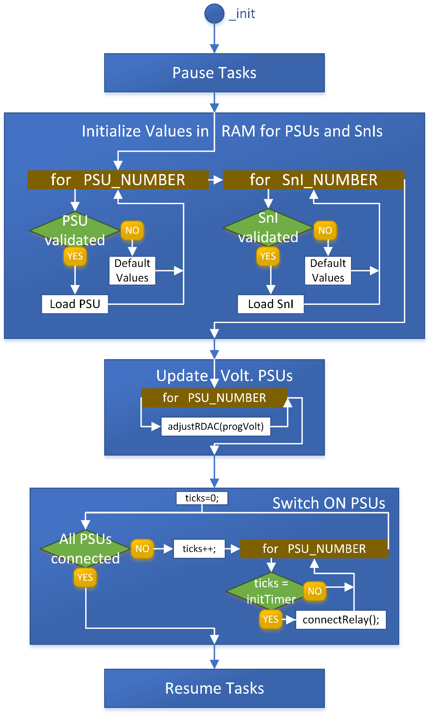
Code being executed
Status, defined by values in white background
Conditional ( IF structure )
Conditional Results (YES/NO)
_end

Slide 22
Supply System
Radiofrequency System
Antennas System
Control and Synchronization System
Processing System

Slide 23

1
User Manual
Numbers or symbols in brackets next to the menu options (seen in the UI) are the keys to be pressed.
The menus are navigated using regular characters ( A-Z and 0-9 ) and several symbols (+ - * ).
The decimal values use the dot (.) as separator (e.g. 5.45V).
The Program menu allows changes in the system, while the Displaymenu presents the system status and configuration
Action
Sequence
Interface Menu
ProgramMenu
Selections and Programming
Switch ON a PSU
2
1
PSUs Sel. → Switch ON
Switch OFF a PSU
2
1
PSUs Sel. → Switch OFF
Change Voltage PSU
2
2
PSUs Sel. → + or - → new Voltage
Connect/Disconnect alarm for PSUs
2
3
PSUs Sel. → Alarms → Con/Discon
Configure PSU alarms
2
4
PSUs Sel. → Alarms Sel. → Alarm Menu¹
Configure Timing for Switch ON
2
5
PSUs Sel. → new Timing
Configure SnI alarms
2
6
SnIs Sel. → Alarms Sel. → Alarm Menu¹
Configure Timing for Switch ON
2
7
SnIs Sel. → Alarms Sel. → Con/Discon
Read the programmed and measured volts/Currs
Display Menu
1
1
Status Display²
Check the alarms’ status
1
1
Check the alarms’ configurations
1
2
Config Display³
(1) Alarm Menu
Configure limit Time
1
New Time
Configure limit value
2
New Value
Configure Timing for Switch ON
3
Protocol Sel. → Activate/Deactivate
Configure PSUs to be shutdown with alarm
4
PSUs Sel.
Configure new Voltage
to be set with alarm
5
New Voltage Value

Slide 24
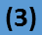
(2) Status Display
PSU number (1 to 6, A or B) and status (ON/OFF)
Programmed Voltage
| 1A-ON Vp=15.50 V |
| vO=14.95 I-Dis/S-Con |
| cO=0.35 I-Lim/S-Trg |
Measured Current
Dis - Disconnected
Con – Connected
Lim – Limit Reached
Trg – Triggered
Alarm Status
(Inferior/Superior limits) .
Measured Voltage
(3) Config Display
PSU number (1 to 6, A or B) and status (ON/OFF)
Alarm status and protocols for all alarms
| 1A-OFF c…d###d.#.c##. |
| vi 15.45 t100 16.50/FFF |
| vs 17.55 t20 16.20/001 |
| ci 0.45 t0 16.50/002 |
| cs 3.75 t500 16.50/004 |
4 characers for each alarm (vi, vs, ci, cs). The characters mean:
Connected(c)/disconnected(d)
Protocol Shutdown ON(#)/OFF(.)
Protocol Voltage ON(#)/OFF(.)
Protocol Message ON(#)/OFF(.)
alarm limit Value
alarm limit Time
(x100ms)
Protocol Shutdown: PSUs to be shutdown multiplexed (e.g. 004 = PSU 3, FFF = all PSUs)
Protocol Modify Voltage
Alarm type: Voltage(v)/Current(c) + Interior(i)/Superior(s)

